Slide 1
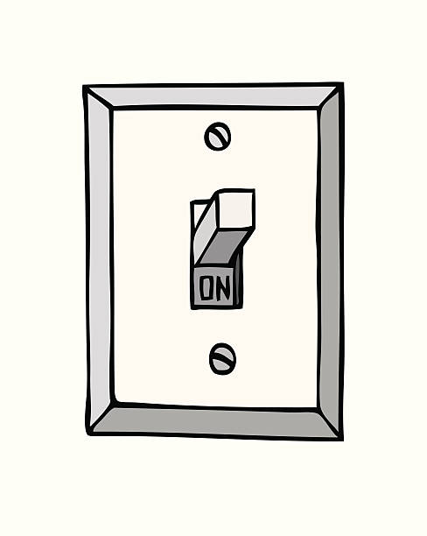

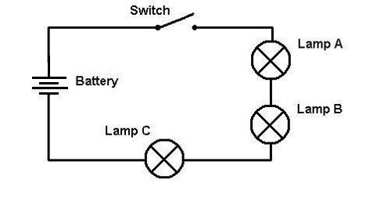
A Light Switch
Input Objects
Processes & Logic
Output Objects
What happens when you flip the light switch?
What different things could happen?

Slide 2
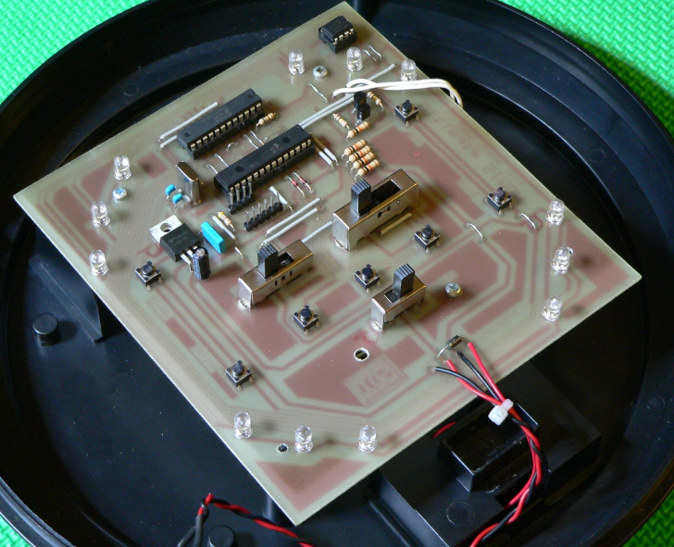
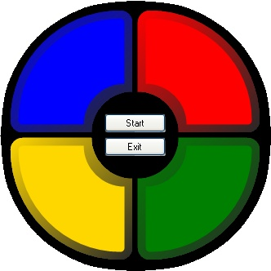
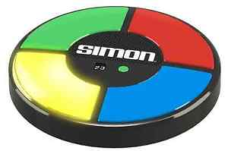
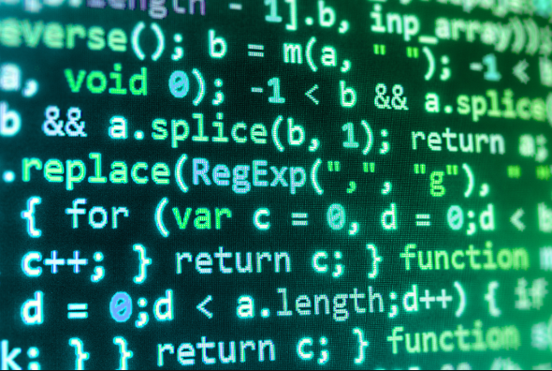
The Simon Game
Input Objects
Processes & Logic
Output Objects
Hardware
Software
What happens when you press the green button?
What different things could happen?

